Slide 1
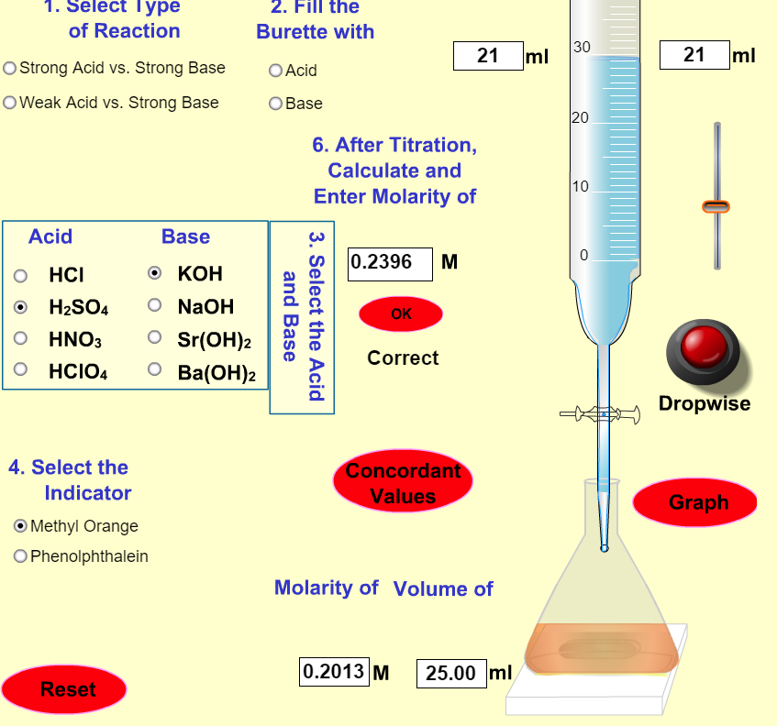


Titration
AP Chem
https://www.youtube.com/watch?v=sFpFCPTDv2w
https://pages.uoregon.edu/tgreenbo/acid_base.html

Slide 2
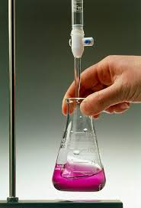
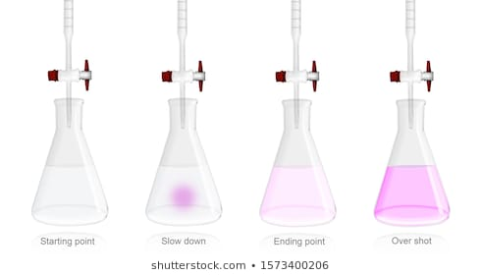
Titration
AP Chem
https://www.youtube.com/watch?v=sFpFCPTDv2w

Slide 3
https://www.youtube.com/watch?v=9pS7Q4MQCYI

Slide 4
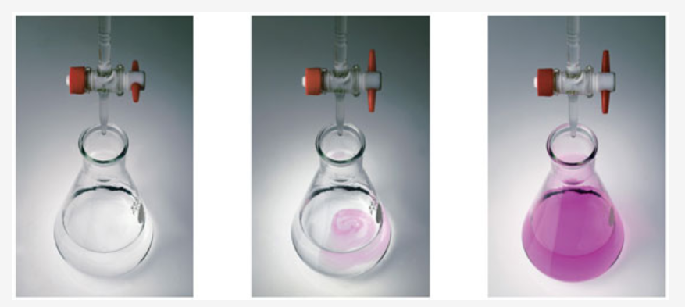
How to reach the endpoint of a titration
https://chemskills.com/sites/default/files/titration.jpg

Slide 5
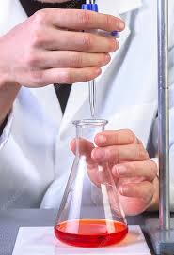
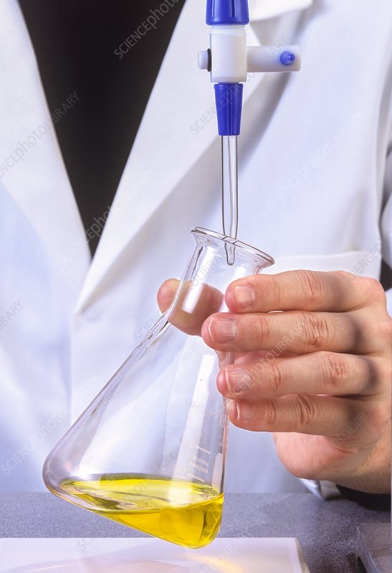
Data Table
Name________________________
Complete the chart using the Titration lab simulation @
https://pages.uoregon.edu/tgreenbo/acid_base.html
Combination | Indicator | Base Molarity | Base Volume | Acid Molarity | Acid Volume | Sample Calculation
 | M or P
HCl vs NaOH | Trial 1 2 3
HCl vs KOH
HCl vs Sr(OH)₂
H₂SO₄ vs KOH | Trial 1 2 3
HClO₄ vs Ba(OH)₂
CH₃COOH vs NaOH | Trial 1 2 3
methyl orange
bromthymol blue
phenolpthalein

Slide 6
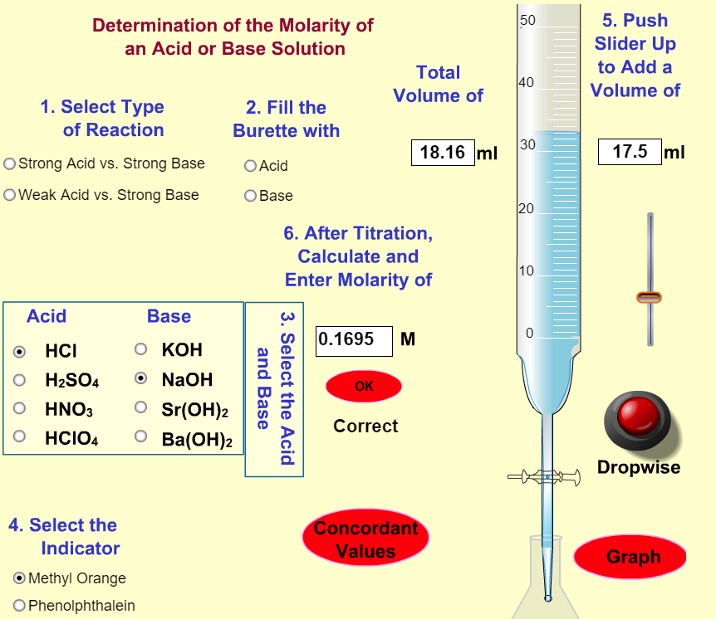
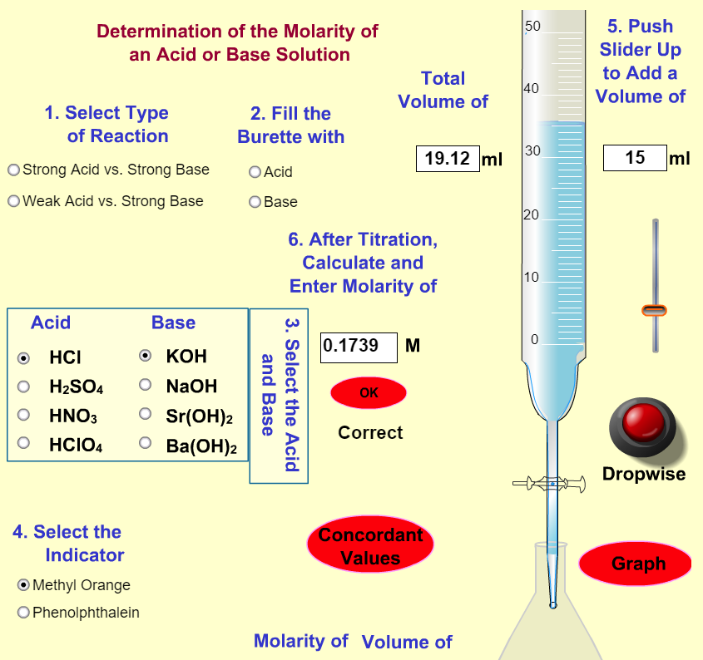
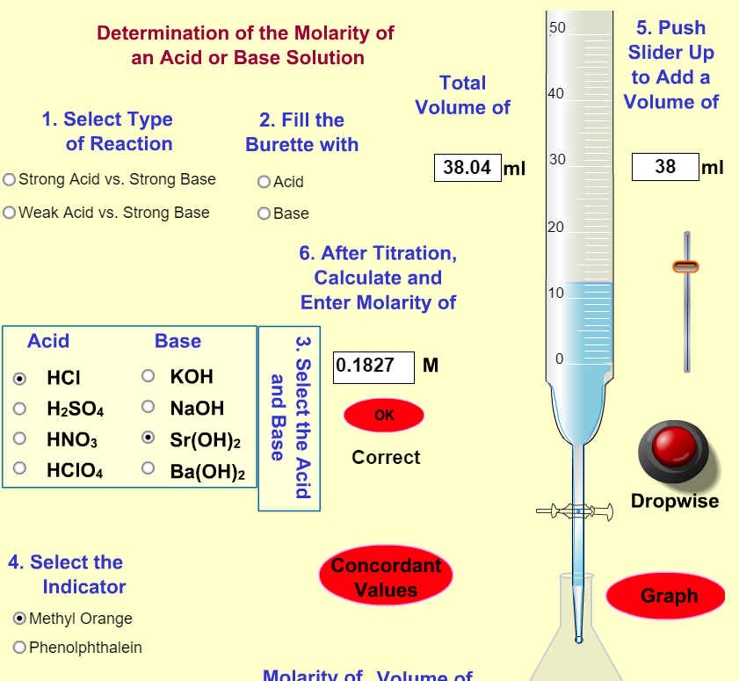
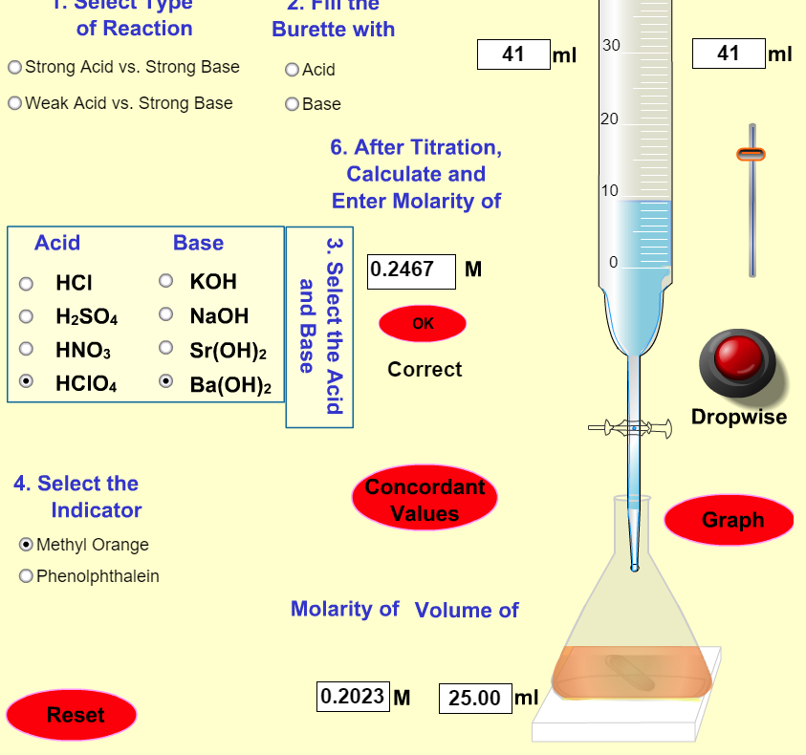
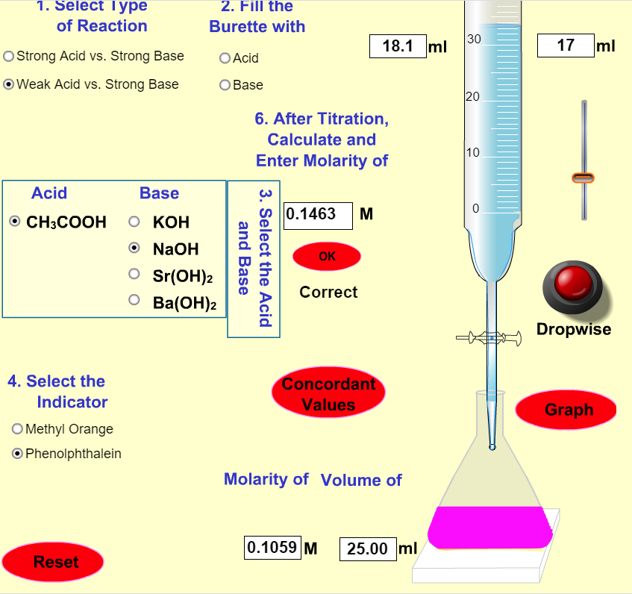

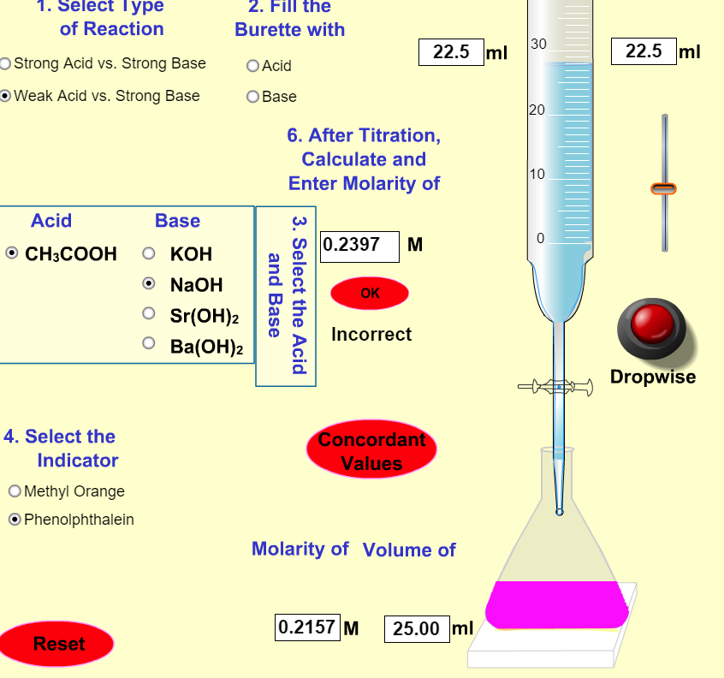
Evidence of Completion
HCl vs NaOH HCl vs. KOH HCl vs Sr(OH)₂ H₂ SO₄ vs KOH
HClO₄ vs Ba(OH)₂ CH₃COOH vs. NaOH CH₃COOH vs NaOH CH₃COOH vs NaOH

Slide 7
Range and Color Changes of Some
Common Acid-Base Indicators
pH Scale
1
2
3
4
5
6
7
8
9
10
11
12
13
14
Indicators
Methyl orange red 3.1 – 4.4 yellow
Methyl red red 4.4 6.2 yellow
Bromthymol blue yellow 6.2 7.6 blue
Neutral red red 6.8 8.0 yellow
Phenolphthalein colorless 8.0 10.0 red colorless beyond 13.0
Bromthymol blue indicator would be used in titrating a strong acid with a strong base.
Phenolpthalein indicator would be used in titrating a weak acid with a strong base.
Methyl orange indicator would be used in titrating a strong acid with a weak base.
Notes:
From F. Brescia et al., Chemistry: A Modern Introduction, W. B. Saunders Co., 1978.
Adapted from R. Bates, Determination of pH, Theory and Practice, John Wiley & Sons, Inc., New York, 1964.
Choosing the correct indicator for an acid-base titration
1. For titrations of strong acids and strong bases (and vice versa), any indicator with a pK_{in} between 4 and 10 will do
2. For the titration of a weak acid, the pH at the equivalence point is greater than 7, and an indicator such as phenolphthalein or thymol blue, with pK_{in} > 7, should be used
3. For the titration of a weak base, where the pH at the equivalence point is less than 7, an indicator such as methyl red or bromcresol blue, with pK_{in} < 7, should be used

Slide 8
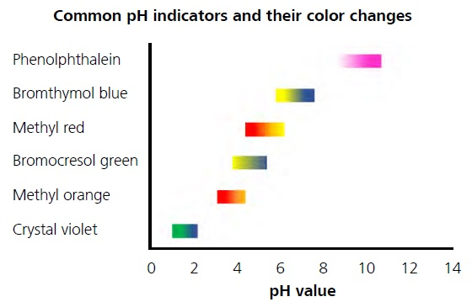
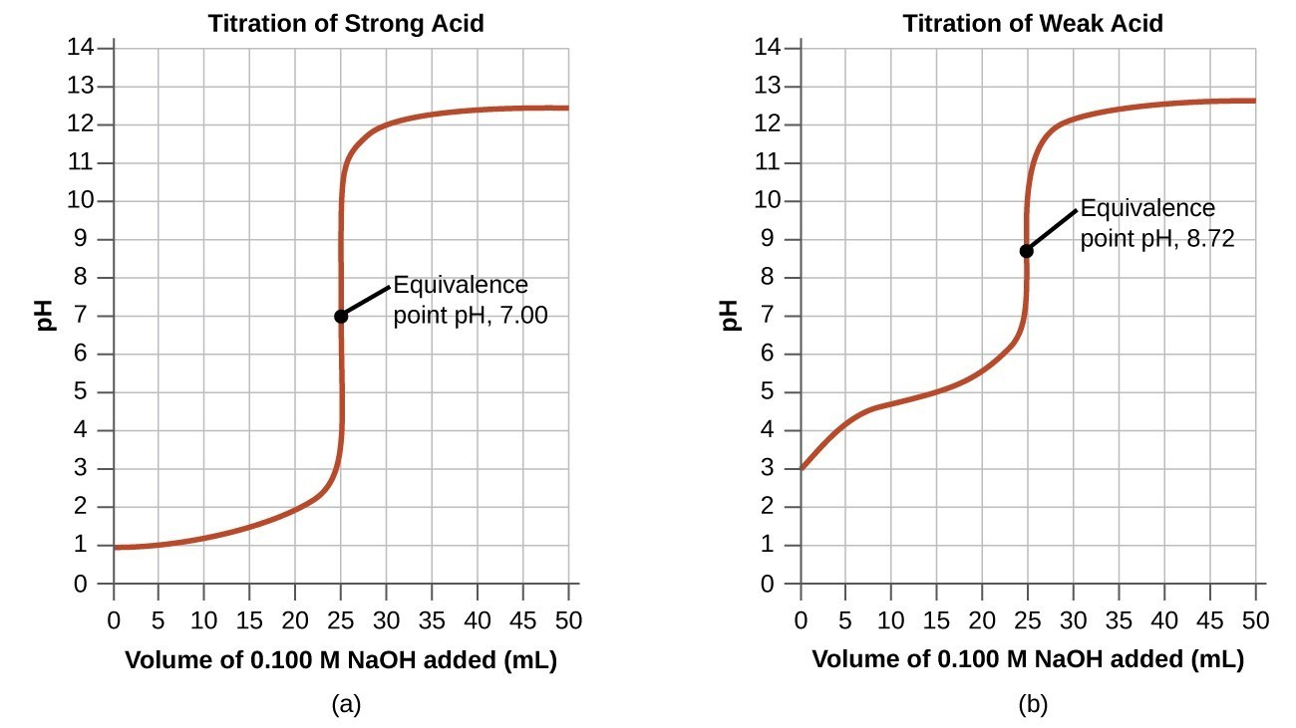
phenolpthalein
bromthymol blue
methyl orange

Slide 9
bromthymol blue
phenolpthalein

Slide 10
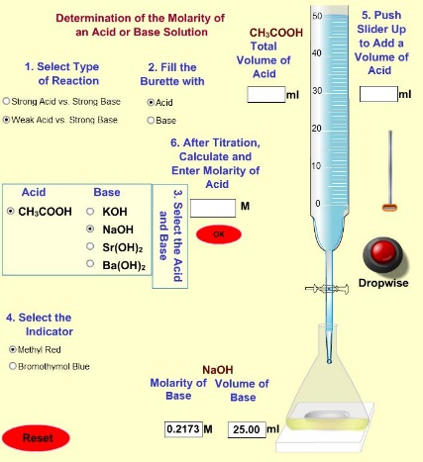
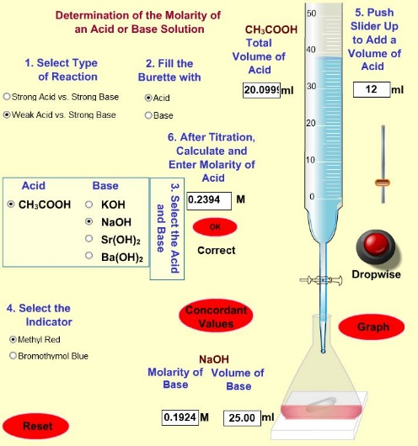
Step 1: Select the Weak acid vs. Strong base option.
Step 2: Select the option to fill the buret with acid
Step 3: Select CH₃COOH as the acid (acetic acid) and NaOH as the base (sodium hydroxide)
Step 4: Select methyl red as the Indicator
Using Firefox as the web browser, open the following link.
(https://pages.uoregon.edu/tgreenbo/acid_base.html)
A. Starting point | B. The endpoint

Slide 11
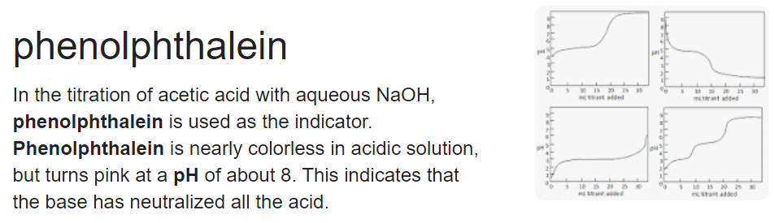
Follow the stepwise procedure using the simulation, noting that the acid, CH₃COOH (acetic acid) is in the buret
and the base (NaOH) is the flask and methyl red indicator is the indicator, so our color change is from yellow to red.
At the first indication of the color changing to red you need to stop adding the acid.
Run the simulation as many times you may wish until you can get a good endpoint.
The end point will be when the color in the flask changes from yellow to red with one drop of acid.
The best way to do it is to add the acid dropwise so that you don’t over titrate.
Run the simulation and record the concentrations and volumes of the base and the volumes of the acid.
Calculate the concentration of the acid. Remember, if you titrate correctly the program will let you know
if your calculated concentration of the acid is correct.
Take a few screen captures to show your acid concentrations are correct .

Slide 12
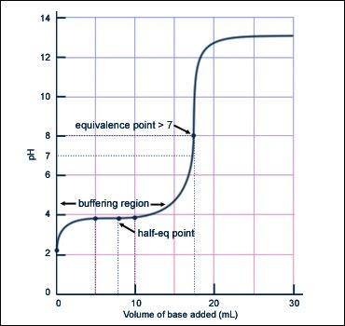

Slide 13
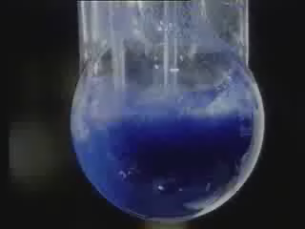
pH Indicators

Slide 14
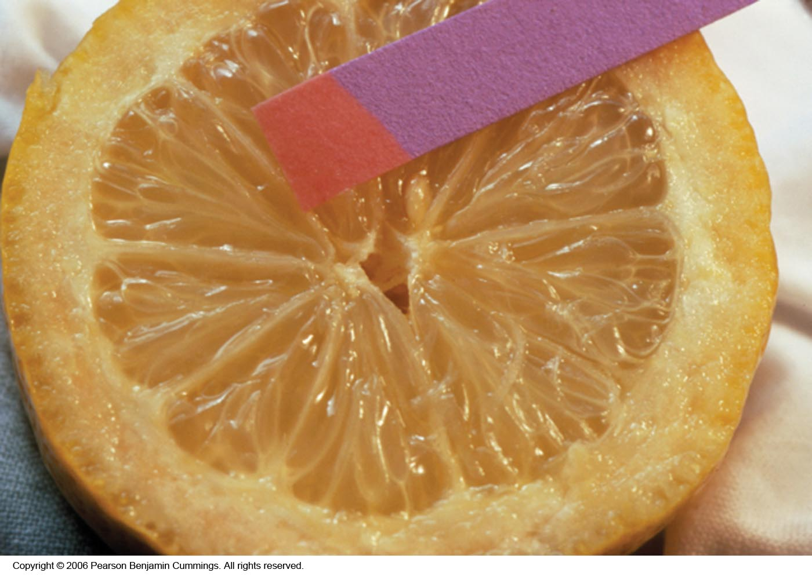
Litmus Paper
Copyright © 2007 Pearson Benjamin Cummings. All rights reserved.

Slide 15
pH Paper
pH 0 1 2 3 4 5 6
pH 7 8 9 10 11 12 13

Slide 16
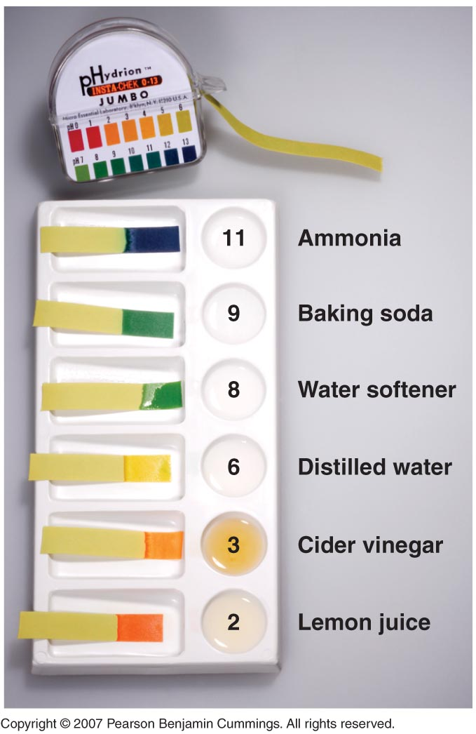
Copyright © 2007 Pearson Benjamin Cummings. All rights reserved.
Notes:
Paper or plastic strips that contain combinations of indicators estimate the pH of a solution by simply dipping a piece of pH paper into it and comparing the resulting color with standards printed on the container

Slide 17
Desired Features of Sensors
pH paper 1904
pH 0 1 2 3 4 5 6
pH 7 8 9 10 11 12 13
Detection limit
Low deflection
High sensitivity
High selectivity
Wide dynamic range
Simple to use
Cost-effective
Notes:
Most acid-base titrations are not monitored by recording the pH as a function of the amount of the strong acid or base solution used as a titrant
Instead, an acid-base indicator is used, and they are compounds that change color at a particular pH and if carefully selected, undergo a dramatic color change at the pH corresponding to the equivalence point of the titration
Acid-base indicators are typically weak acids or bases whose changes in color correspond to deprotonation or protonation of the indicator itself
The chemistry of indicators are described by the general equation HΙn_{(aq)} ⇋ H⁺ _{(aq)} + Ιn–_{(aq)}, where the protonated form is designated by HΙn and the conjugate base by Ιn–
The ionization constant for the deprotonation of indicator HΙn is K_{in} = [H⁺] [Ιn–] / [HΙn]
The value of pK_{in} determines the pH at which the indicator changes color A good indicator must have the following properties:
1. Color change must be easily detected
2. Color change must be rapid
3. Indicator molecule must not react with the substance being titrated
4. The indicator should have a pK_{in} that is within one pH unit of the expected pH at the equivalence point of the titration
• Synthetic indicators have been developed that meet the above criteria and cover the entire pH range
• An indicator does not change color abruptly at a particular pH but undergoes a pH titration like any other acid or base

Slide 18
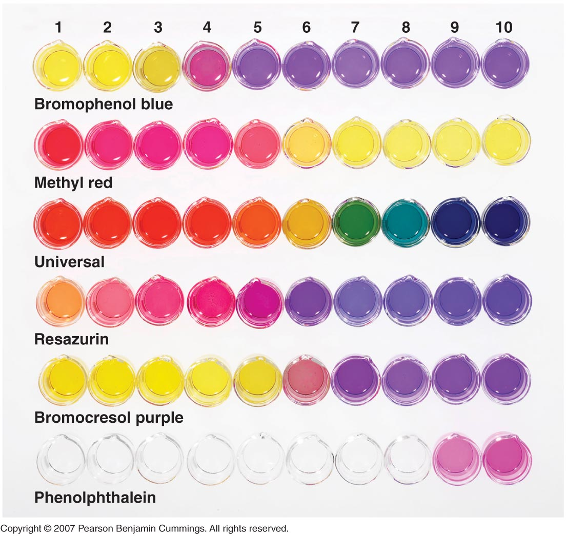
pH
Copyright © 2007 Pearson Benjamin Cummings. All rights reserved.

Slide 19
INDICATOR COLORS IN TITRATION
Indicator
Acid color
Transition color
Base color
STRONG ACID – STRONG BASE
Litmus
2 3 4 5 6 7 8 9 10 11 12
pH
Bromthymol blue

Slide 20
INDICATOR COLORS IN TITRATION
Indicator
Acid color
Transition color
Base color
WEAK ACID – STRONG BASE
Phenolphthalein
2 3 4 5 6 7 8 9 10 11 12
pH
Phenol red

Slide 21
INDICATOR COLORS IN TITRATION
Indicator
Acid color
Transition color
Base color
STRONG ACID – WEAK BASE
Methyl orange
2 3 4 5 6 7 8 9 10 11 12
pH
Bromphenol blue

Slide 22
Indicator
1
2
3
4
5
6
7
8
9
10
11
12
Phenolphthalein
Colorless
Pink
Red
Methyl Red
Red
Orange
Yellow
Orange IV
Orange
Peach
Yellow

Slide 23
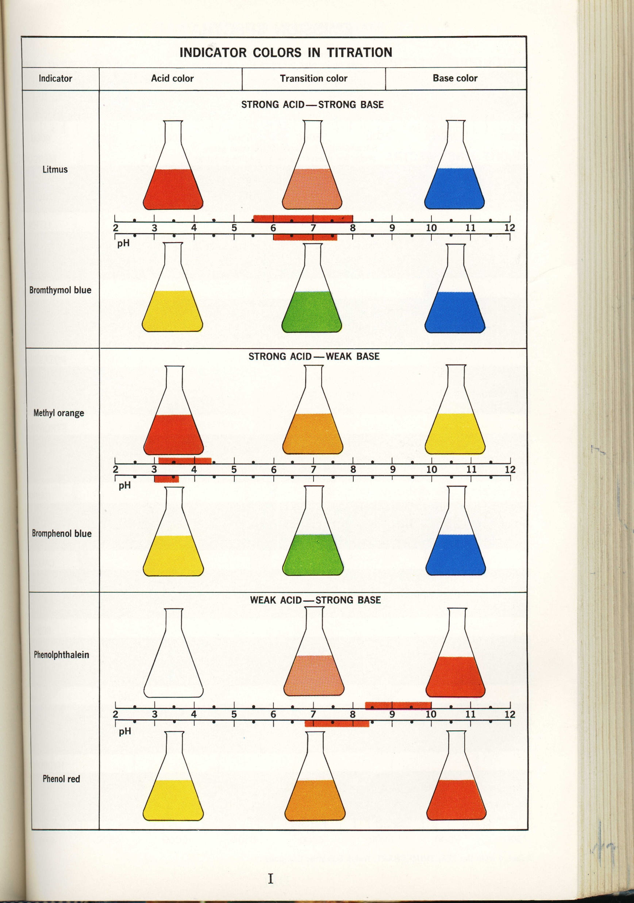
Indicator Colors in Titration

Slide 24
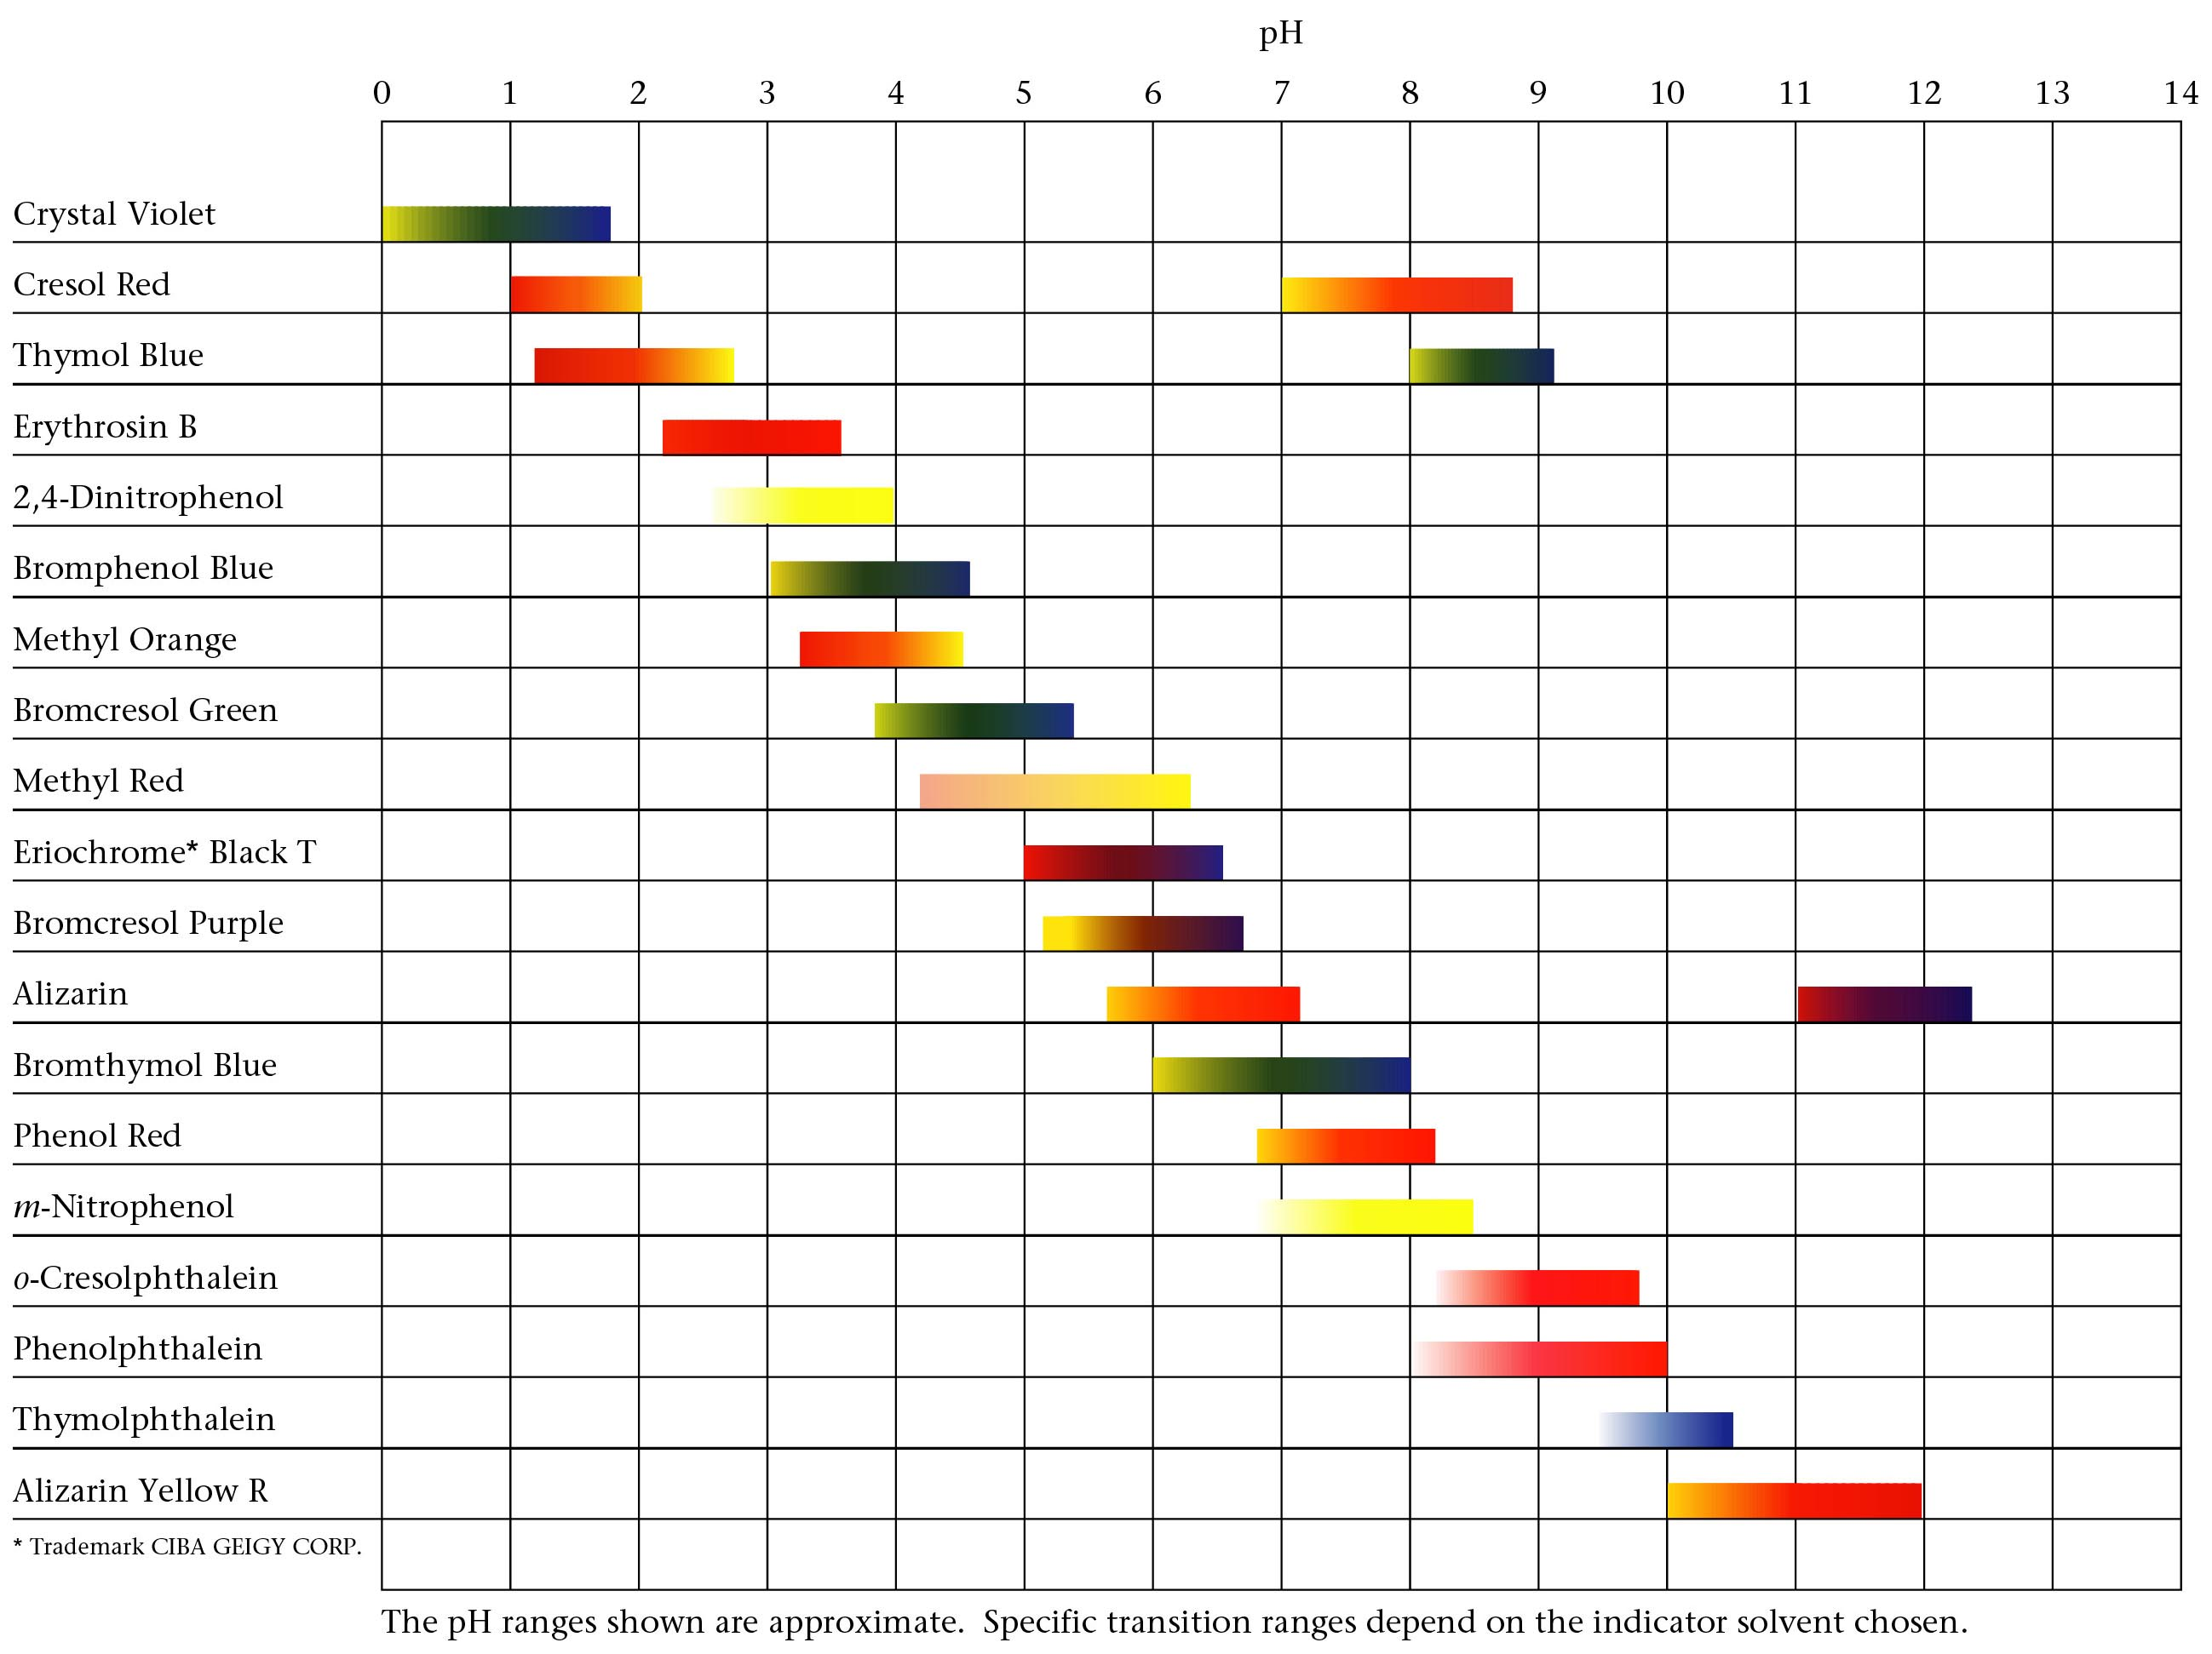
Common pH Indicators
Zumdahl, Zumdahl, DeCoste, World of Chemistry 2002, page 520

Slide 25
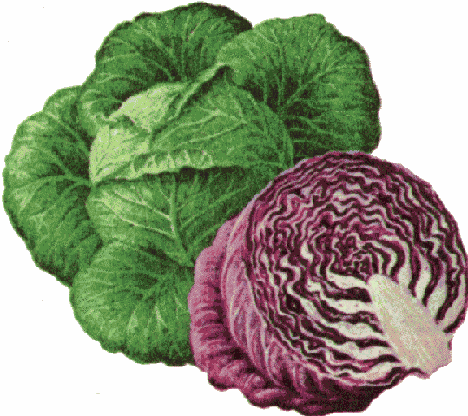
Edible Acid-Base Indicators
COLOR CHANGES AS A FUNCTION OF pH
INDICATOR pH 2 3 4 5 6 7 8 9 10 11 12
RED APPLE SKIN
BEETS
BLUEBERRIES
RED CABBAGE
CHERRIES
GRAPE JUICE
RED ONION
YELLOW ONION
PEACH SKIN
PEAR SKIN
PLUM SKIN
RADISH SKIN
RHUBARB SKIN
TOMATO
TURNIP SKIN
*
*YELLOW at pH 12 and above
Notes:
Source: Volume 62, Number 4, April 1985 pg 285 (Not sure of magazine title)

Slide 26
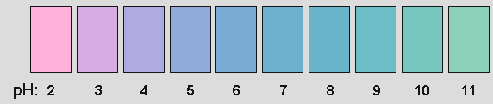
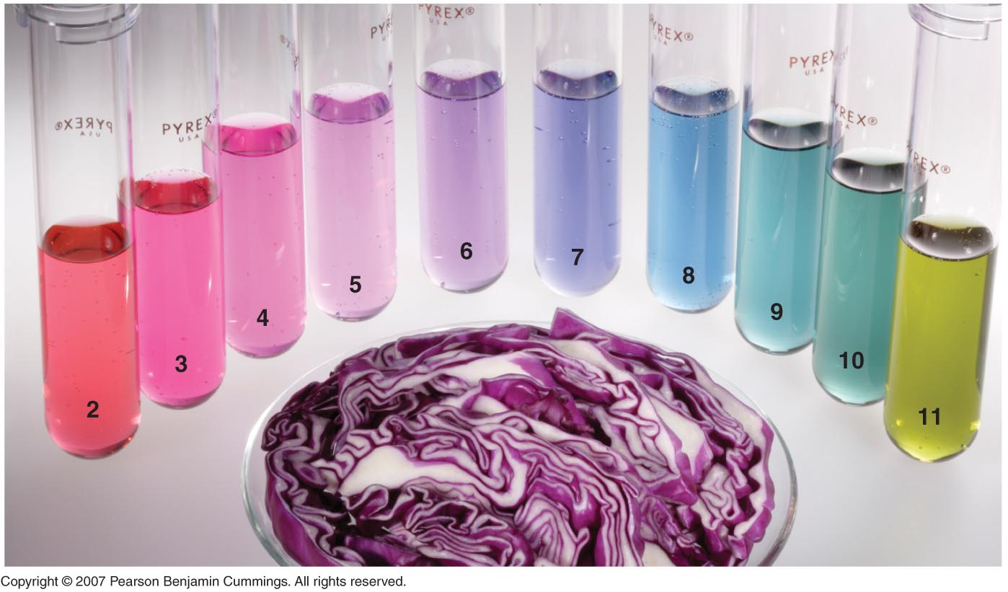
Red Cabbage Indicator
Copyright © 2007 Pearson Benjamin Cummings. All rights reserved.

Slide 27
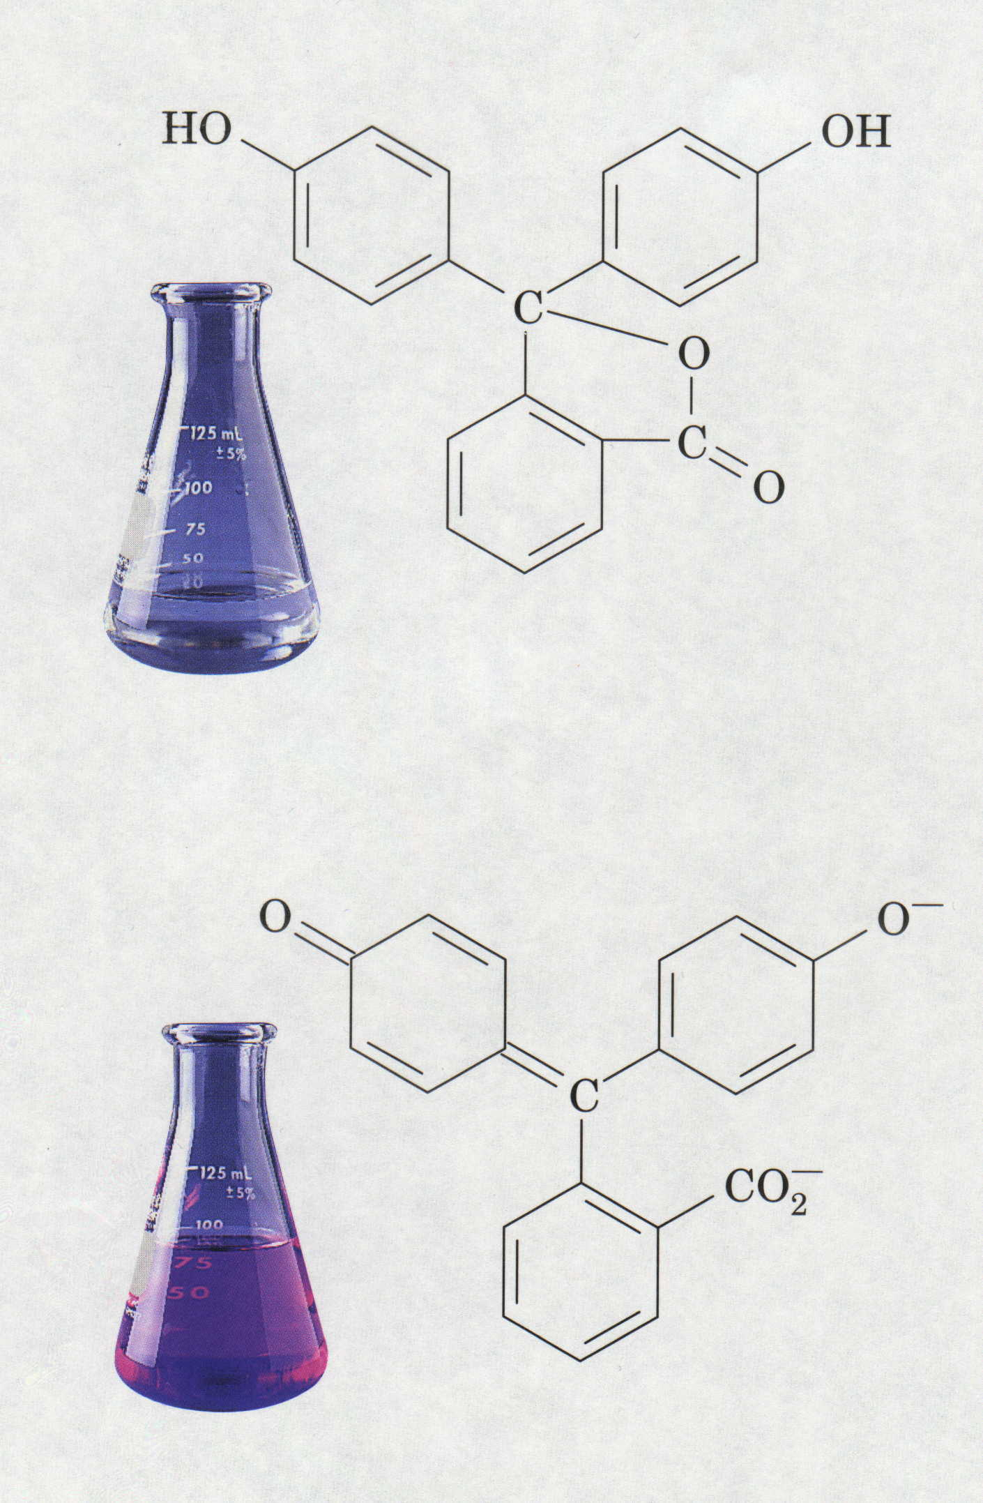
Phenolphthalein Indicator
H⁺
Colorless = Acidic pH
Pink = Basic pH

Slide 28
⁻O
OH
O
HO
C
C
OH
C
O⁻
C
O⁻
O
O
(Colorless acid form, HIn)
(Pink base form, In⁻)

Slide 29
Titration

Slide 30
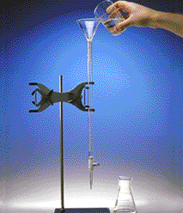
Titration
Titration
  Analytical method in which a standard solution is used to determine the concentration of an unknown solution.
standard solution
unknown solution
Courtesy Christy Johannesson www.nisd.net/communicationsarts/pages/chem
Notes:
Quantitative analysis — used to determine the amounts or concentrations of substances present in a sample by using a combination of chemical reactions and stoichiometric calculations
Titration
– A method in which a measured volume of a solution of known concentration, called the titrant, is added to a measured volume of a solution containing a compound whose concentration is to be determined (the unknown)
– Reaction must be fast, complete, and specific (only the compound of interest should react with the titrant)
– Equivalence point — point at which exactly enough reactant has been added for the reaction to go to completion

Slide 31
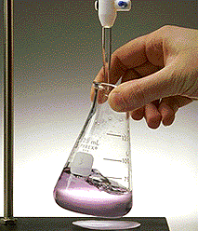
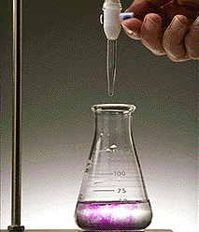
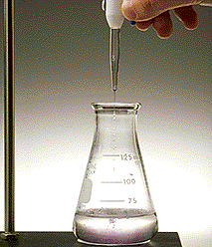
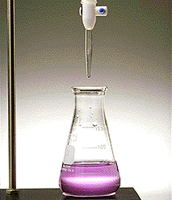
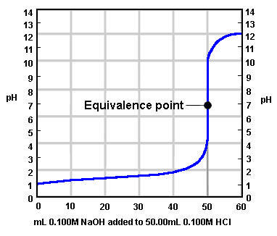
Titration
Equivalence point (endpoint)
  Point at which equal amounts of H₃O⁺ and OH⁻ have been added.
  Determined by…
    indicator color change
    dramatic change in pH
Courtesy Christy Johannesson www.nisd.net/communicationsarts/pages/chem
Notes:
Most common acids and bases are not intensely colored
– Rely on an indicator
Endpoint — point at which a color change is observed, which is close to the equivalence point in an acid-base titration

Slide 32
Titration
moles H₃O⁺ = moles OH⁻
M⋅V⋅ n = M⋅V⋅ n
M: Molarity
V: volume
n: # of H⁺ ions in the acid
or OH⁻ ions in the base
Courtesy Christy Johannesson www.nisd.net/communicationsarts/pages/chem

Slide 33
Titration
42.5 mL of 1.3M KOH are required to neutralize 50.0 mL of H₂SO₄. Find the molarity of H₂SO₄.
H₃O⁺
M = ?
V = 50.0 mL
n = 2
OH⁻
M = 1.3M
V = 42.5 mL
n = 1
MV# = MV#
M(50.0mL)(2)
=(1.3M)(42.5mL)(1)
M = 0.55M H₂SO₄
Courtesy Christy Johannesson www.nisd.net/communicationsarts/pages/chem
Notes:
A reaction in which an acid and a base react in stoichiometric amounts to produce water and a salt
Strengths of the acid and base determine whether the reaction goes to completion
1. Reactions that go to completion
a. Reaction of any strong acid with any strong base
b. Reaction of a strong acid with a weak base
c. Reaction of weak acid with a weak base
2. Reaction that does not go to completion is a reaction of a weak acid or a weak base with water

Slide 34
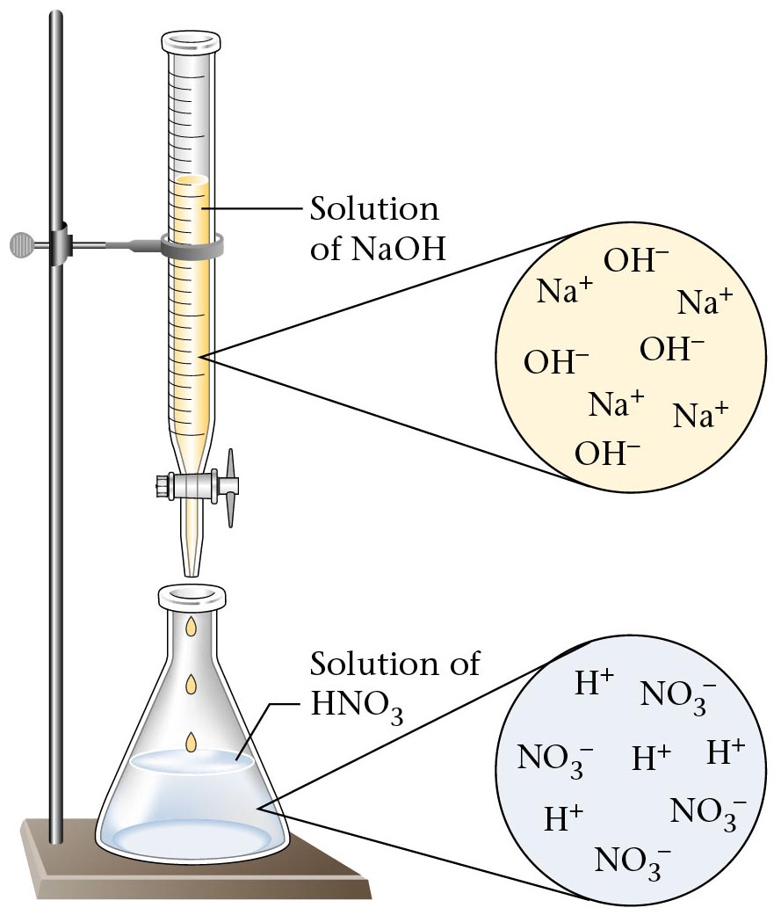
Acid-Base Titration
Notes:
In acid-base titrations, a buret is used to deliver measured volumes of an acid or base solution of known titration (the titrant) to a flask that contains a solution of a base or an acid, respectively, of unknown concentration (the unknown).
If the concentration of the titrant is known, then the concentration of the unknown can be determined.
Plotting the pH changes that occur during an acid-base titration against the amount of acid or base added produces a titration curve; the shape of the curve provides important information about what is occurring in solution during the titration.
Before addition of any strong base, the initial [H₃O⁺] equals the concentration of the strong acid.
Addition of strong base before the equivalence point, the point at which the number of moles of base (or acid) added equals the number of moles of acid (or base) originally present in the solution, decreases the [H₃O⁺] because added base neutralizes some of the H₃O⁺ present.
Addition of strong base at the equivalence point neutralizes all the acid initially present and pH = 7.00; the solution contains water and a salt derived from a strong base and a strong acid.
Addition of a strong base after the equivalence causes an excess of OH– and produces a rapid increase in pH.
A pH titration curve shows a sharp increase in pH in the region near the equivalence point and produces an S-shaped curve; the shape depends only on the concentration of the acid and base, not on their identity.
For the titration of a monoprotic strong acid with a monobasic strong base, the volume of base needed to reach the equivalence point can be calculated from the following relationship:
moles of base = moles of acid
(volume)_{b} (molarity)_{b} = (volume)_{a} (molarity)_{a}
V_{b}M_{b} = V_{a}M_{a}

Slide 35
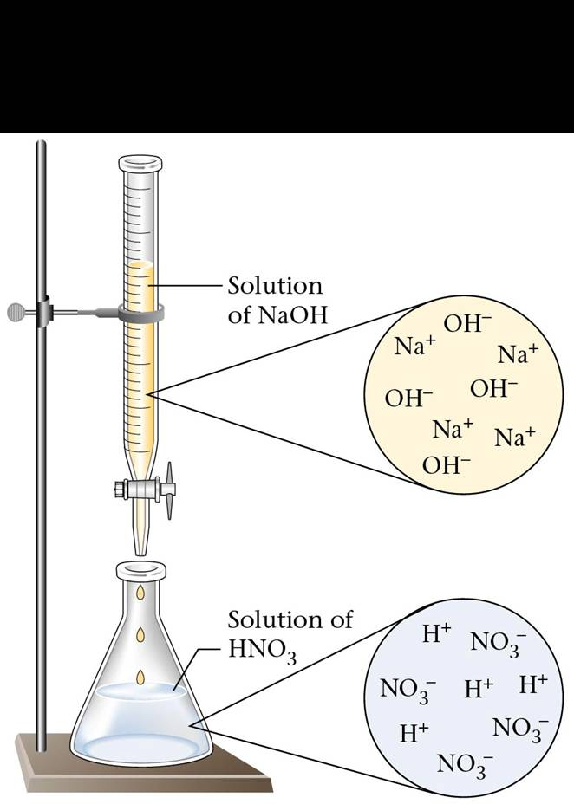
Data Table
0.10 M HCl
? M NaOH
Calibration Curve
0.00 mL
1.00 mL
2.00 mL
4.00 mL
9.00 mL
17.00 mL
27.00 mL
48.00 mL
1.00 mL
1.00 mL
2.00 mL
5.00 mL
8.00 mL
10.0 mL
15.0 mL
Base (mL)
Acid (mL)
Solution
of NaOH
Solution
of NaOH
Create calibration curve of six data points
Using [HCl], determine concentration of NH₃
Determine vinegar concentration using [NaOH]
determined earlier in lab
Solution
of HCl
5 mL
Notes:
A solution whose concentration is known precisely
Used to determine the concentration of the titrant
Accuracy of any titration analysis depends on accurate knowledge of the concentration of the titrant
Most titrants are first standardized—their concentration is measured by titration with a standard solution

Slide 36
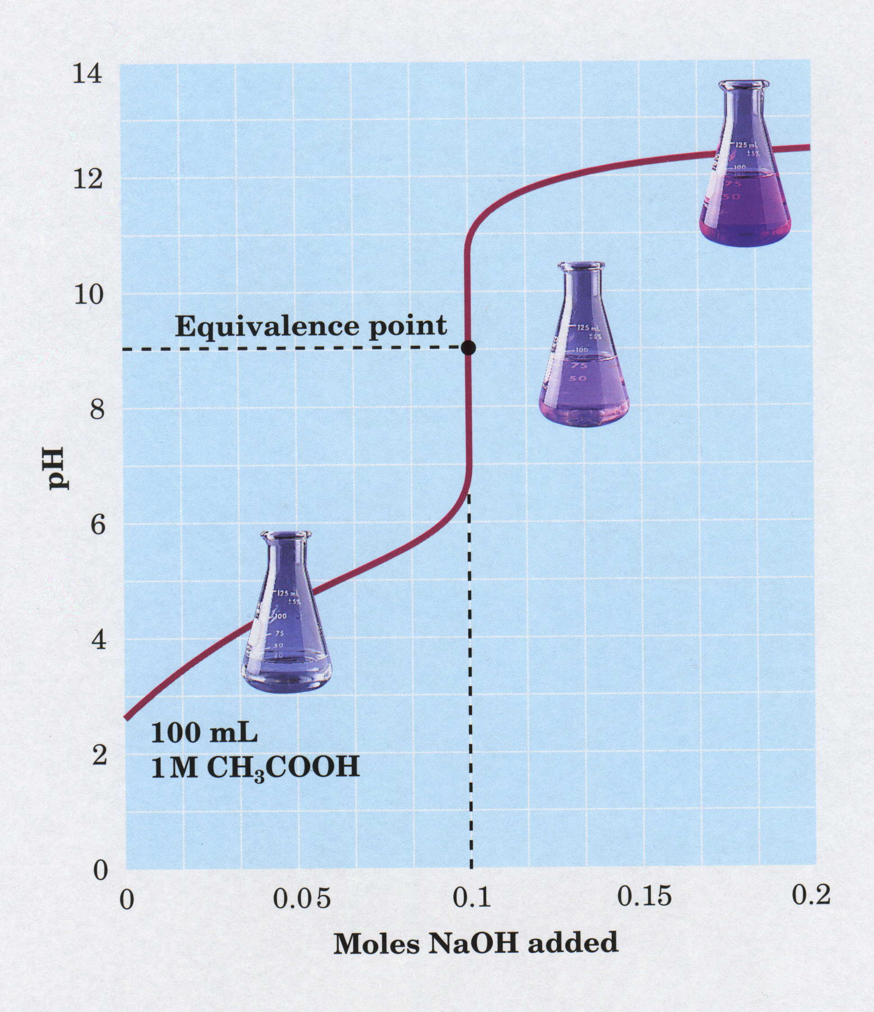
Titration Curve

Slide 37

Titration
indicator
changes color
to indicate pH change
e.g. phenolpthalein is colorless in acid
and pink in basic solution
endpoint
pink
equivalence
point
pH
7
Pirate…”Walk the plank”
once in water, shark eats and
water changes to pink color
colorless
base

Slide 38
Calibration Curve
endpoint
pink
Base (mL)
pH
equivalence
point
7
Acid (mL)
colorless
Pirate…”Walk the plank”
once in water, shark eats and
water changes to pink color
base
indicator
- changes color to indicate pH change
e.g. phenolphthalein is colorless in acid
and pink in basic solution

Slide 39
Calibration Curve
endpoint
pink
Base (mL)
pH
equivalence
point
7
Acid (mL)
colorless
Pirate…”Walk the plank”
once in water, shark eats and
water changes to pink color
base
indicator
- changes color to indicate pH change
e.g. phenolphthalein is colorless in acid
and pink in basic solution

Slide 40
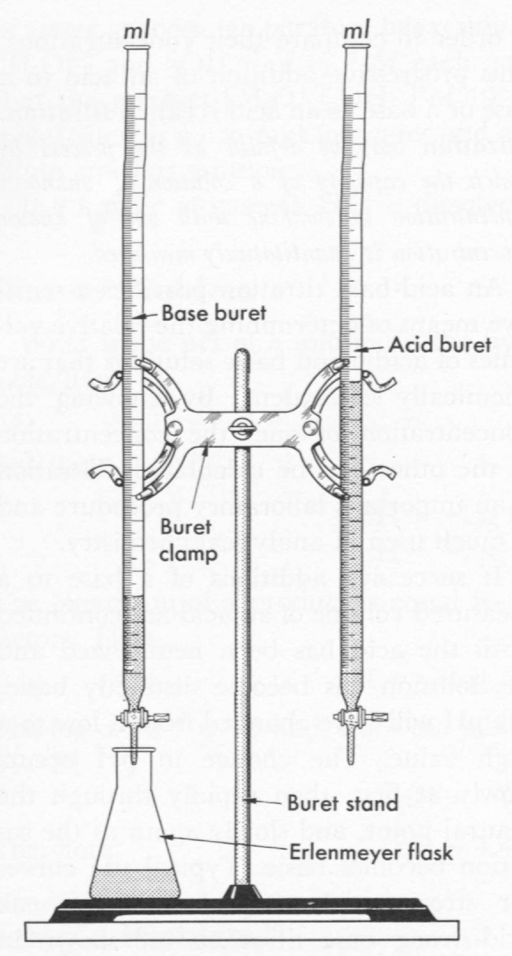
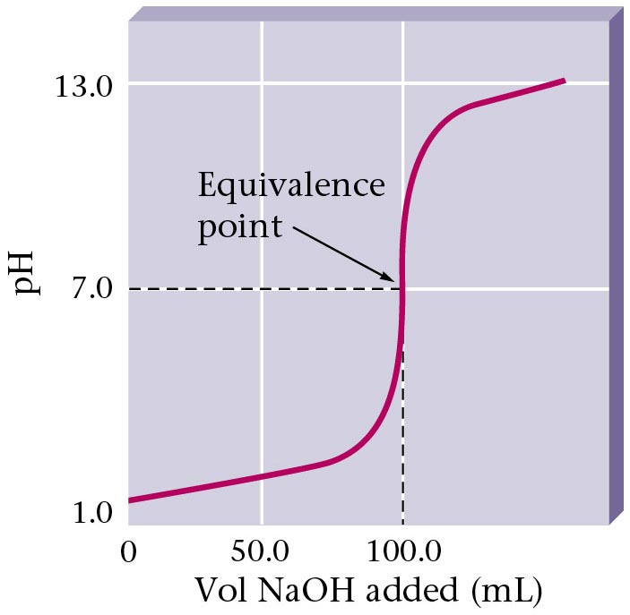
Titration Curve
Zumdahl, Zumdahl, DeCoste, World of Chemistry 2002, page 527

Slide 41
Acid-Base Titrations
Titration of a Strong Acid With a Strong Base
14.0
12.0
Solution
of NaOH
Solution
of NaOH
10.0
Na⁺
OH⁻
Na⁺
OH⁻
OH⁻
pH
8.0
Na⁺
Na⁺
equivalence point
OH⁻
6.0
4.0
Solution
of HCl
H⁺
2.0
Cl
Cl⁻
H⁺
H⁺
H⁺
Cl⁻
0.0
Cl⁻
0.0
10.0
20.0
30.0
40.0
Volume of 0.100 M NaOH added
(mL)
Adding additional NaOH is added. pH rises as
the equivalence point is approached.
Additional NaOH is added. pH increases and then levels off as
NaOH is added beyond the equivalence point.
Adding NaOH from the buret to hydrochloric acid in the flask,
a strong acid. In the beginning the pH increases very slowly.

Slide 42
Titration Data
NaOH added
(mL) pH
Titration of a Strong Acid With a Strong Base
0.00 1.00
10.00 1.37
20.00 1.95
22.00 2.19
24.00 2.70
25.00 7.00
26.00 11.30
28.00 11.75
30.00 11.96
40.00 12.36
50.00 12.52
14.0
phenolphthalein - pink
12.0
10.0
pH
8.0
equivalence point
6.0
4.0
Solution
of NaOH
phenolphthalein - colorless
Solution
of NaOH
2.0
Na⁺
OH⁻
Na⁺
0.0
OH⁻
OH⁻
0.0
10.0
20.0
30.0
40.0
Na⁺
Na⁺
OH⁻
Volume of 0.100 M NaOH added
(mL)
Solution
of HCl
H⁺
Cl⁻
Cl⁻
H⁺
H⁺
Yellow Blue
25 mL
H⁺
Cl⁻
Bromthymol blue is best indicator: pH change 6.0 - 7.6
Cl⁻

Slide 43
Titration of a Strong Acid With a Strong Base
(20.00 mL of 0.500 M HCl by 0.500 M NaOH)
14.0
12.0
Color change
alizarin yellow R
10.0
Color change
phenolpthalein
8.0
equivalence
point
Color change
bromthymol blue
pH
6.0
4.0
Color change
bromphenol blue
2.0
Color change
methyl violet
0.0
0.0
10.0
20.0
30.0
Volume of 0.500 M NaOH added
(mL)
Hill, Petrucci, General Chemistry An Integrated Approach 2nd Edition, page 680
Notes:
Any indicator that changes color along the steep portion of the titration curve is suitable for the titration.
Methyl violet changes color too soon, and alizarin yellow R too late.
Titration curve for the titration of a strong acid with a strong base.
(1) The pH is low at the beginning of the titration.
(2) The pH changes slowly until just before the equivalence point.
(3) Just before the equivalence point, the pH rises sharply.
(4) At the equivalence point, the pH is 7.00.
(5) Just pass the equivalence point, the pH continues its sharp rise.
(6) Further beyond the equivalence point, the pH continues to increase, but much more slowly.
(7) Any indicator whose color changes in the pH range from about 4 to 10 can be used in the titration of a strong acid with a strong base.

Slide 44
Titration of a Weak Acid With a Strong Base
Titration of a Weak Acid With
a Strong Base
Titration Data
14.0
NaOH added
(mL) pH
12.0
10.0
0.00 2.89
5.00 4.14
10.00 4.57
12.50 4.74
15.00 4.92
20.00 5.35
24.00 6.12
25.00 8.72
26.00 11.30
30.00 11.96
40.00 12.36
equivalence point
pH
8.0
6.0
4.0
2.0
0.0
0.0
10.0
20.0
30.0
40.0
Volume of 0.100 M NaOH added
(mL)
Phenolphthalein is best indicator: pH change 8.0 - 9.6
Notes:
The shape of the titration curve for a weak acid or a weak base depends dramatically on the identity of the acid or base and the corresponding value of K_{a} or K_{b}.
The pH changes much more gradually around the equivalence point in the titration of a weak acid or a weak base.
[H⁺] of a solution of a weak acid (HA) is not equal to the concentration of the acid but depends on both its pK_{a} and its concentration.
Only a fraction of a weak acid dissociates, so [H⁺] is less than [HA]; therefore, the pH of a solution of a weak acid is higher than the pH of a solution of a strong acid of the same concentration.
Comparing the titration curve of a strong acid with a strong base with the titration curve of a weak acid and a strong base
1. Below the equivalence point, the two curves are very different; before any base is added, the pH of the weak acid is higher than the pH of the strong acid
2. pH changes more rapidly during the first part of the titration in a weak acid and strong base titration
3. Due to the higher starting pH, the pH of the weak acid at the equivalence point is greater than 7.00, so solution is basic
4. Change in pH for the weak acid/strong base titration around the equivalence point is about half as large as for the strong acid titration; the magnitude of the change at the equivalence point depends on the pK_{a} of the acid being titrated
5. Above the equivalence point, the two curves are identical; once acid has been neutralized, the pH of the solution is controlled only by the amount of excess of OH– present, regardless of
Calculating the pH of a solution of a
weak acid or base
– If K_{a} or K_{b} and the initial concentration of a weak acid or base are known, one can calculate the pH of a solution of a weak acid or base by setting up a table of initial concentrations, changes in concentrations, and final concentrations
– Define x as [H⁺] due to the dissociation of the acid
– Insert values for final concentrations into the equilibrium equation and solve for x and then pH (pH = –log[H⁺])
Calculating the pH during titration of a
weak acid or base
– Solved in two steps: a stoichiometric calculation followed by an equilibrium calculation
1. Use stoichiometry of the neutralization reaction to calculate the amounts of acid and conjugate base present in solution after the neutralization reaction has occurred
2. Use the equilibrium equation K = [H₃O⁺] [A–] / [H₂O] [HA] to determine [H⁺] of the resulting solution
Identity of the weak acid or base being titrated strongly affects the shape of the titration curve.
The shape of titration curves as a function of the pK_{a} or pK_{b} shows that as the acid or base being titrated becomes weaker (its pK_{a} or pK_{b} becomes larger), the pH change around the equivalence point decreases significantly.
The midpoint of a titration is defined as the point at which exactly enough acid (or base) has been added to neutralize one-half of the acid (or base) originally present and occurs halfway to the equivalence point.
At the midpoint of the titration of an acid, [HA] = [A–].
The pH at the midpoint of the titration of a weak acid is equal to the pK_{a} of the weak acid.

Slide 45
Titration of a Weak Base With a Strong Acid
Titration of a Weak Base With a Strong Acid
Titration Data
14.0
HCl added
(mL) pH
12.0
10.0
0.00 11.24
10.00 9.91
20.00 9.47
30.00 8.93
40.00 8.61
45.00 8.30
47.00 7.92
48.00 7.70
49.00 7.47
50.00 5.85
51.00 3.34
pH
8.0
6.0
equivalence point
4.0
2.0
0.0
0.0
10.0
20.0
30.0
40.0
50.0
Volume of 0.100 M HCl added
(mL)

Slide 46
7. What is the pH of a solution made by dissolving 2.5 g NaOH in 400 mL water?
Determine number of moles of NaOH
x mol NaOH = 2.5 g NaOH
0.0625 mol NaOH
Calculate the molarity of the solution
[Recall 1000 mL = 1 L]
M_{NaOH} = 0.15625 molar
NaOH
Na¹⁺ + OH¹⁻
0.15625 molar
0.15625 molar
0.15625 molar
pOH = -log [OH⁻]
or
k_{W} = [H⁺] [OH⁻]
pOH = -log [0.15625 M]
1 x 10⁻¹⁴ = [H⁺] [0.15625 M]
pOH = 0.8
[H⁺] = 6.4 x 10⁻¹⁴ M
pOH + pH = 14
pH = -log [H⁺]
0.8 + pH = 14
pH = 13.2
pH = -log [6.4 x 10⁻¹⁴ M]

Slide 47
What volume of 0.5 M HCl is required to titrate 100 mL of 3.0 M Ca(OH)₂?
"6.0 M"
2
HCl + Ca(OH)₂
CaCl₂ + HOH
2
x mL
100 mL
0.5 M
3.0 M
M₁V₁ = M₂V₂
M₁V₁ = M₂V₂
(0.5 M) (x mL) = (3.0 M) (100 mL)
(0.5 M) (x mL) = (6.0 M) (100 mL)
x = 600 mL of 0.5 M HCl
x = 1200 mL of 0.5 M HCl
HCl
Ca(OH)₂
mol
mol_{HCl} = M x L
mol = M x L
Ca(OH)₂
M
L
mol = (0.5 M)(0.6 L)
mol = (3.0 M)(0.1 L)
mol = 0.3 mol HCl
mol = 0.3 mol Ca(OH)₂
HCl
H¹⁺ + Cl¹⁻
Ca(OH)₂
Ca²⁺ + 2OH¹⁻
0.3 mol
0.3 mol
0.3 mol
0.3 mol
0.3 mol
0.6 mol
[H⁺] = [OH⁻]

Slide 48
6. 10.0 grams vinegar
titrated with
65.40 mL of 0.150 M NaOH
(acetic acid + water)
A)
moles HC₂H₃O₂
=
moles NaOH
mol
M
L
NaOH
mol_{NaOH} = M x L
therefore, you have ...
0.00981 mol HC₂H₃O₂
mol = (0.150 M)(0.0654 L)
mol = 0.00981 mol NaOH
B)
x g HC₂H₃O₂ = 0.00981 mol HC₂H₃O₂
0.59 g HC₂H₃O₂
C)
% =
% =
% = 5.9 % acetic acid
Commercial vinegar is sold as 3 - 5 % acetic acid
Notes:
Commercial vinegar in our labs was tested to be ~1.0 molar acetic acid.

Slide 49
Carboxylic Acid
HC₂H₃O₂
= acetic acid
C₂H₄O₂
H
:
O
:
H
C
C
O
1-
H
H
H⁺
CH₃COOH
R - COOH
carboxylic acid

Slide 50
Ethanol (drinking alcohol)
Acetic acid (vinegar)
O
O
H
H
C
C
H
O
H
H
H

Slide 51
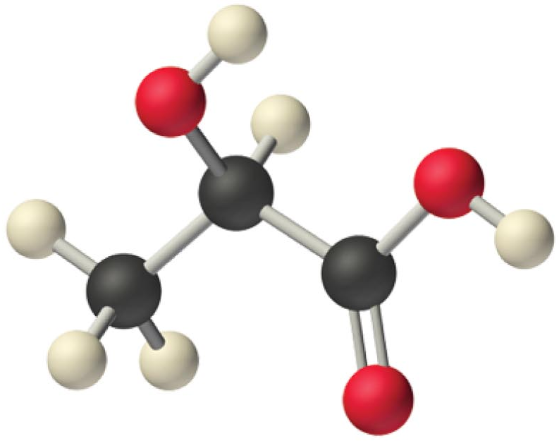
Lactic Acid
OH
H₃C C CO₂H
H
Lactic acid
C₃H₆O₃

Slide 52
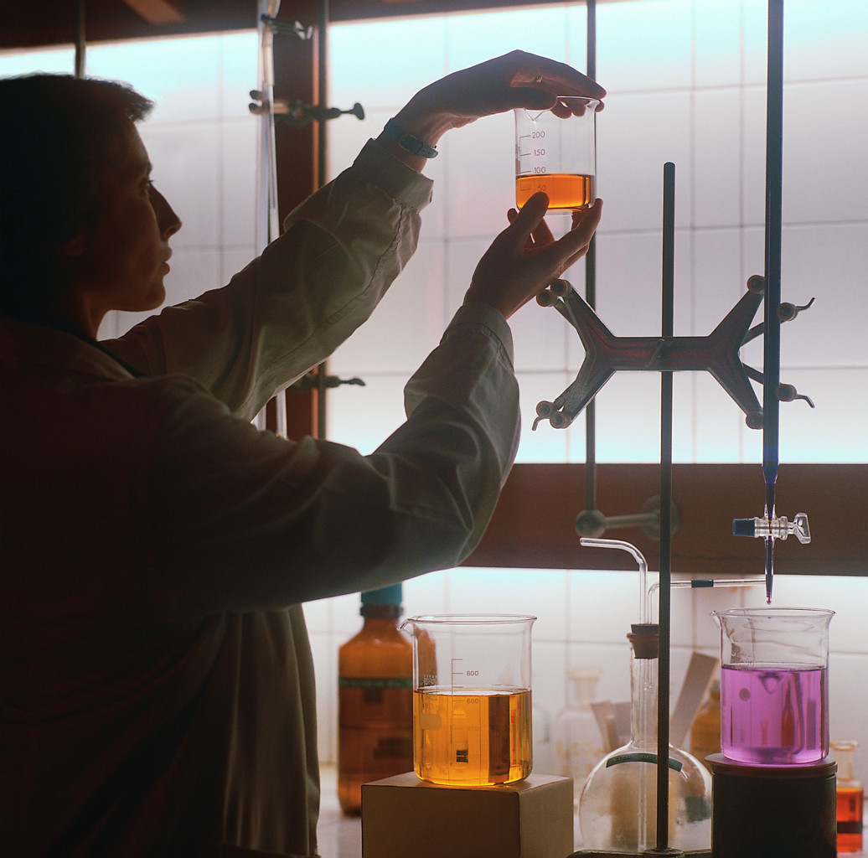
Titration
?
1.0 M HCl
titrate with
? M NaOH
1.00 mL
2.00 mL
M₁ V₁ = M₂ V₂
(1.0 M)(1.00 mL) = (x M)(2.00 mL)
X = 0.5 M NaOH
2.0 M H¹⁺
1.0 M H₂SO₄
titrate with
? M NaOH
1.00 mL
2.00 mL
M₁ V₁ = M₂ V₂
(1.0 M)(1.00 mL) = (x M)(2.00 mL)
X = 0.5 M NaOH

Slide 53

Titration Lab
Determine Concentration of Vinegar
Acids and Bases Titration
Lab 2
Keys
http://www.unit5.org/chemistry/AcidBase.html

